Slide 1

ECE 802, Electric Motor Control Permanent-Magnet Ac Drives Field Weakening Control

Slide 2
Permanent-Magnet Ac Machine Field Weakening Control (Section 14.10)
Dc machines: more torque is available at higher speeds with weaker field
Field weakening is also an option for BDC and IM drives
Typically, field weakening can extend the speed range by about 15%

Slide 3
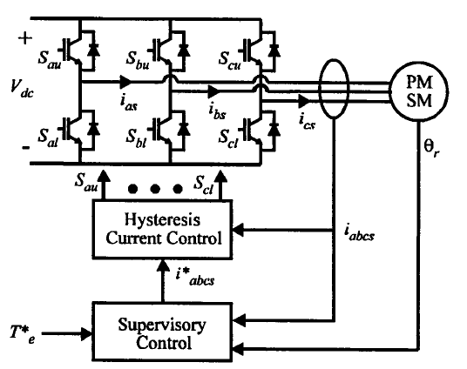
Permanent-Magnet Ac Drive System

Slide 4
Steady-State "Commanded" Voltages
commanded currents:
define commanded voltages:
(1)
(2)
(3)

Slide 5
Voltage Limit
by inverse transformation:
line-to-line voltage:
considering the inverter limit of v_{ab} ≤ V_{dc}

Slide 6
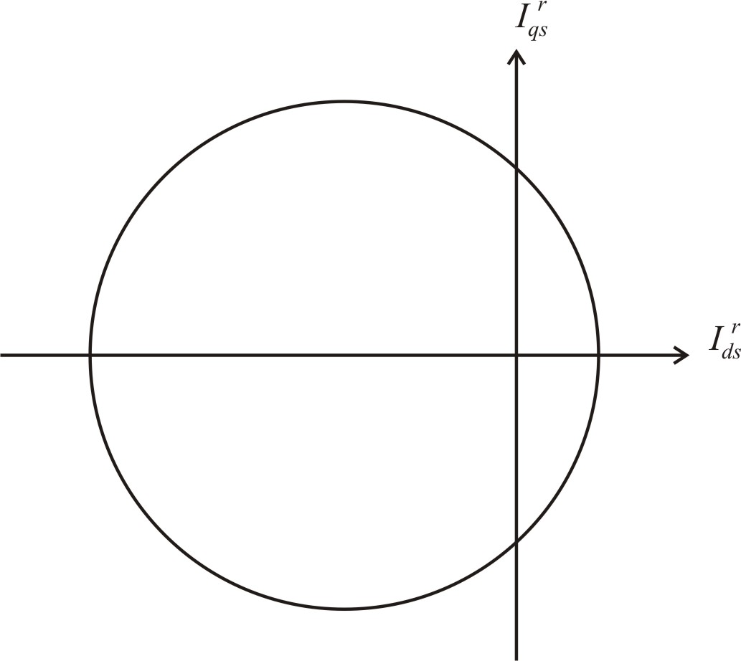
Voltage Limit Ellipse
Current tracking occurs for operation inside the ellipse
Ellipse size decreases with decreasing dc voltage
Ellipse size decreases with increasing speed

Slide 7
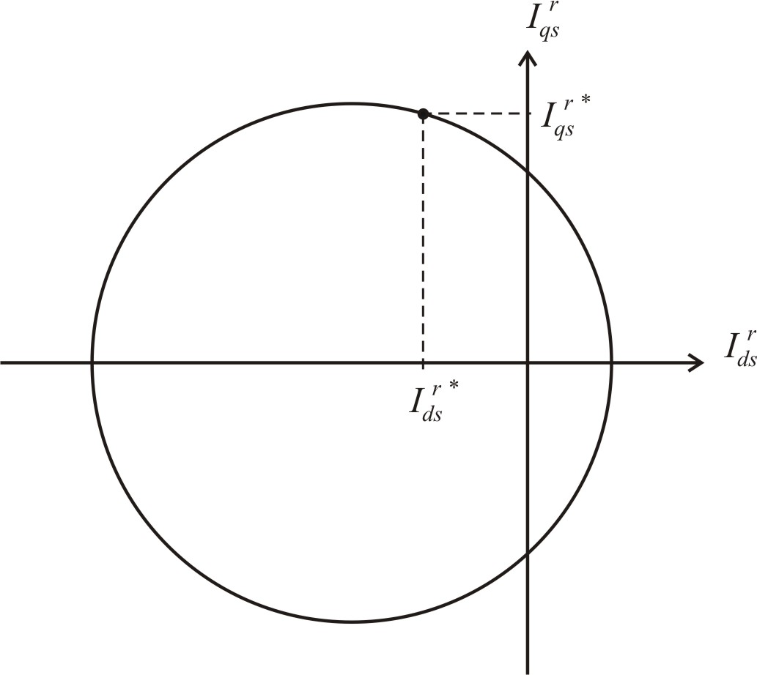
Field Weakening Control

Slide 8
Control 1: Q-Axis Current Control
Substituting (1) and (2) into (3) with the commanded currents
and considering the inverter voltage limit
for current tracking

Slide 9
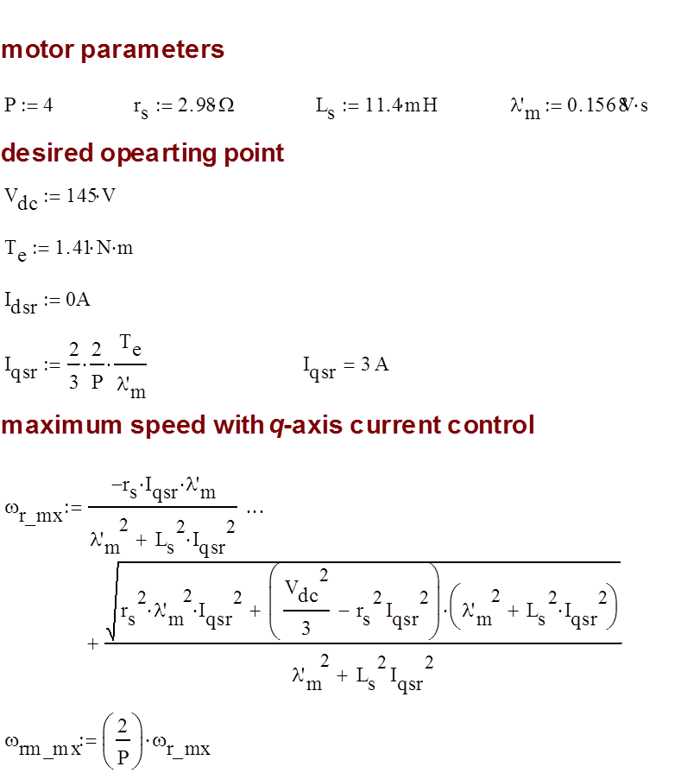
Q-Axis Current Control Calculation Example

Slide 10
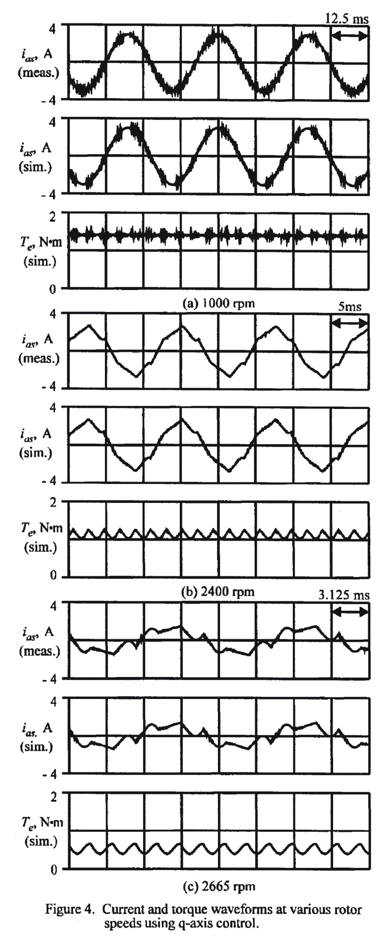


Q-Axis Control Simulated and Measured Results
1000 RPM
2400 RPM
2665 RPM
low-frequency torque ripple is present at 2400 RPM and 2665 RPM
average torque also decreases at 2400 RPM and 2665 RPM

Slide 11
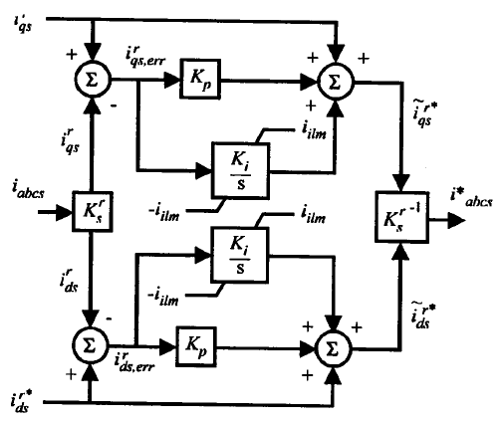
Control 2: Synchronous PI Regulator

Slide 12
PI Regulator Speed Limitation
PI regulator ensures average I_{qs}^{r *} and zero I_{ds}^{r *}
At limit, the inverter operates as 180˚ VSI, then
Using this limit and (1 - 3)
for current tracking

Slide 13
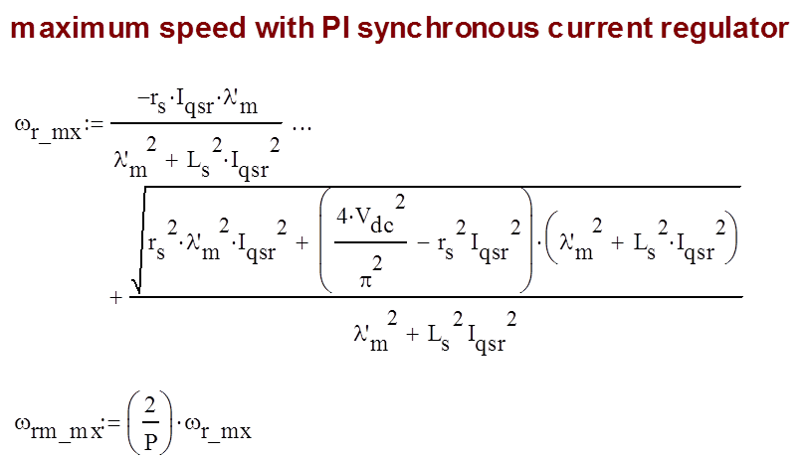
PI Regulator Calculation Example

Slide 14
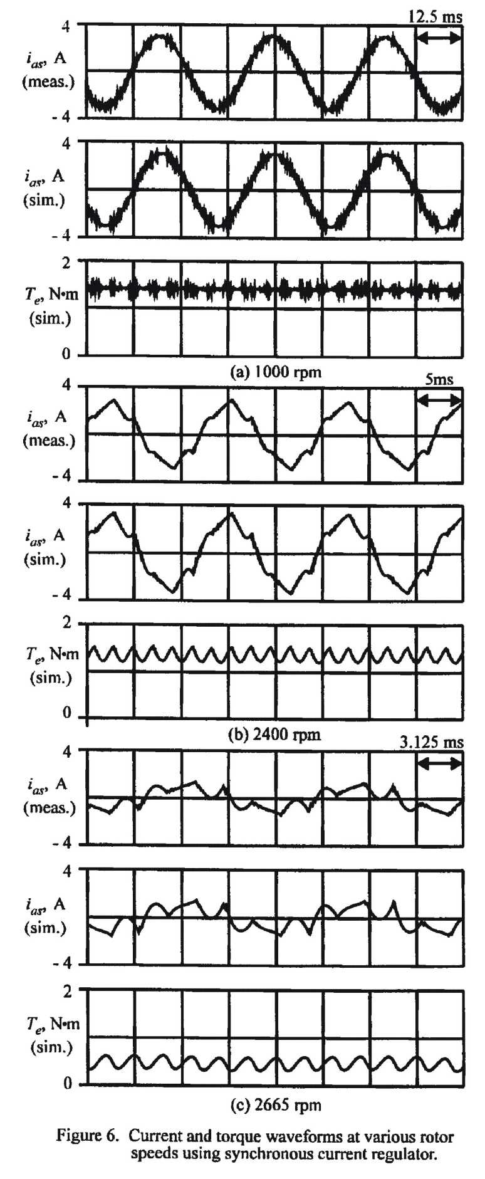


PI Regulator Control Simulated and Measured Results
1000 RPM
2400 RPM
2665 RPM
low-frequency torque ripple is present after 2400 RPM and 2665 RPM
average torque is maintained at 2400 RPM
average torque also decreases at 2665 RPM

Slide 15
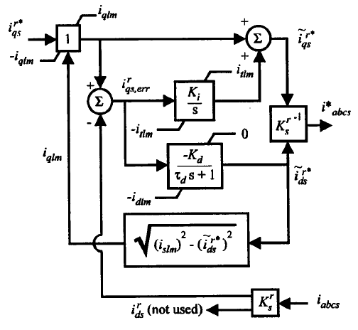
Control 3: Field Weakening (Approximate)
When a large q-axis current error exists, negative d-axis current is injected
Integral control trims out q-axis current error at low speeds
Note: motor parameters, ω_{r}, and V_{dc} not needed in control

Slide 16
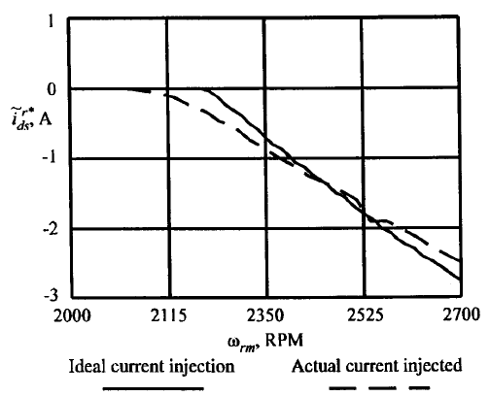
Field Weakening Approximation

Slide 17
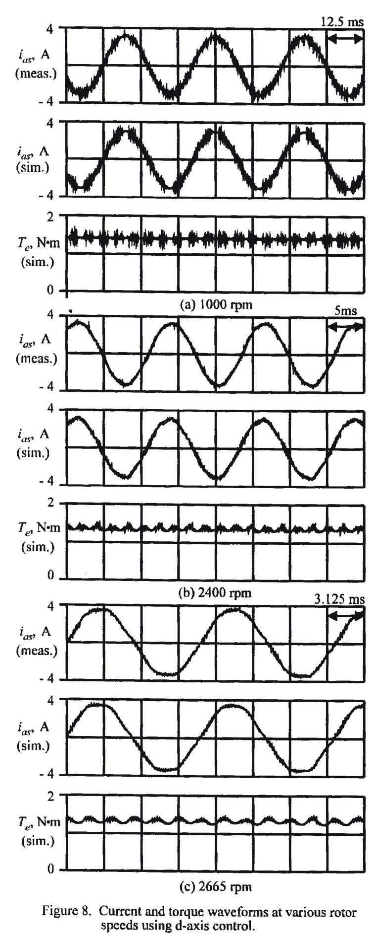


Field Weakening Control Simulated and Measured Results
1000 RPM
2400 RPM
2665 RPM
some torque ripple at 2665 RPM due to approximate implementation
average torque is maintained throughout speed range

Slide 18
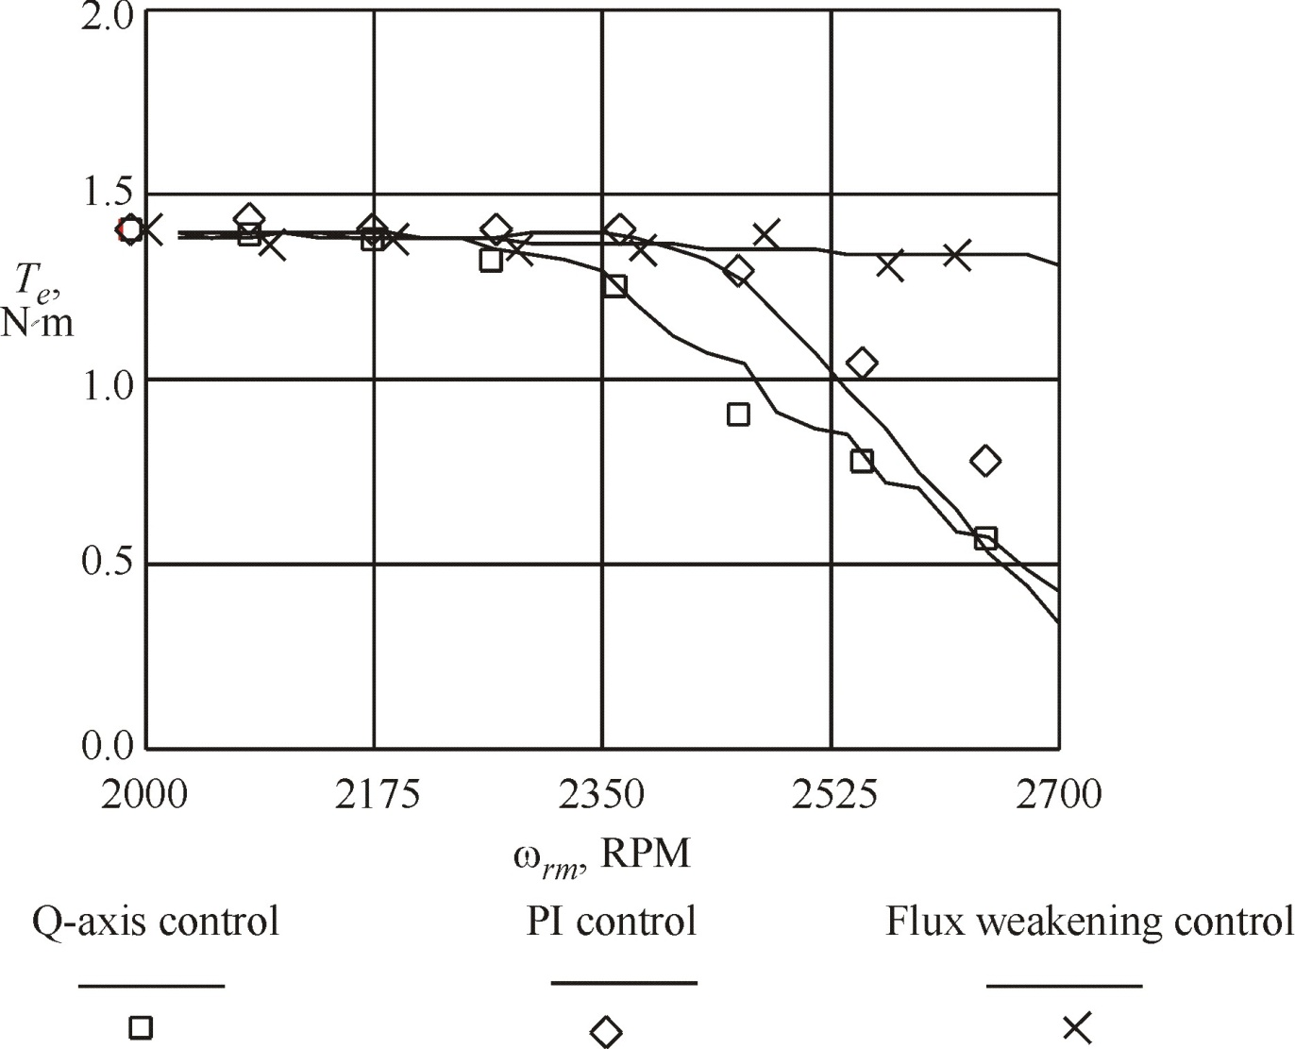
Average Torque Versus Speed

